Slide 1
IoT Tools Overview
Szabolcs.Baranyi@microsoft.com

Slide 2
…IoT is a business revolution, enabled by technology
The Internet of Things isn’t a technology revolution…

Slide 3







Microsoft IoT is already delivering tangible results across industries
Finning: “Finning's IoT solution has enabled customers to quickly solve business problems from a dashboard, transport more than 1 million additional tons of cargo via machine learning, reduce fuel consumption by reducing ideling by 17%, and increase ROI and competitiveness for the long term.”
TETRA PAK: “Tetra Pak's IoT business results show down-time cut down by up to 48 hours for each packaging line saving up to 30,000 Euros for customers. “
DunavNET: “By telling farmers such things as when to irrigate, how to control diseases and where to fight pests, agroNET provides an action plan to maximize efficiency. This solution has seen yield increases of 30% due to data & machine learning informed irrigation decisions and reductions in water use by 20%.”
By analyzing driving trends on its own patrol fleet, RAC has reduced its accident rate by 25%, and reduced fuel usage by 20% - reporting annual savings of $1.8 million
Improves access to production and supply chain data worldwide, reducing downtime costs by as much as $300,000 per day
Tetra Pak's IoT business results show down-time cut down by up to 48 hours for each packaging line saving up to 30,000 Euros for customers. “
Chillers restart 9x faster than unconnected equipment, avoiding more than $300,000 in hourly downtime costs
By telling farmers such things as when to irrigate, how to control diseases and where to fight pests, agroNET provides an action plan to maximize efficiency. This solution has seen yield increases of 30% due to data & machine learning informed irrigation decisions and reductions in water use by 20%.”
Gathers data from sensors and systems to create valuable business intelligence and reduce downtime by 50%
“Finning's IoT solution has enabled customers to quickly solve business problems from a dashboard, transport more than 1 million additional tons of cargo via machine learning, reduce fuel consumption by reducing ideling by 17%, and increase ROI and competitiveness for the long term.”
Ensure the licorice extruders on Twizzler’s production line are performing at peak optimization, saving over $500K/year on licorice alone.
Cutting fuel usage by 1 percent could save $250,000 per plane per year

Slide 4
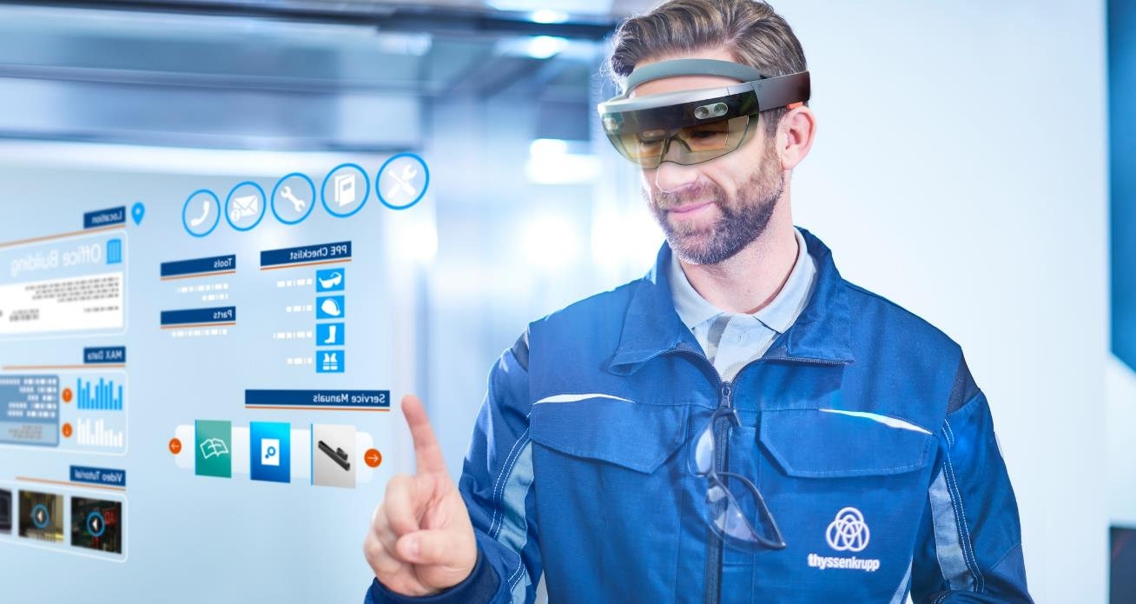
Integrate

Slide 5
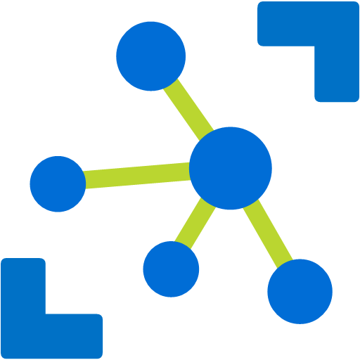

IoT Solutions Have a Common Pattern
Can we make both paas and saas the same color, but the ring around saas can stay red.
We can kill the black borders top and bottom.
Azure IoT Hub
Things
Cloud Gateway
Insights
Actions

Slide 6


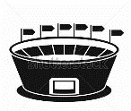
The IoT Pattern is Broadly Applicable Across Industries
Drone
Aircrafts
Cows
Street sweepers
Auto
Electric charging stations
Fryers
Oil equipment
Vending machines
Dogs
Buses
Power plant
Buildings
IoT
Factory floor
Racing
Trucks
Oil distribution
Elevators
Power tools
Vaccine dispensers
Mining equipment
Surveillance
Postboxes
Engines
Smart meters
Smart grids
Medical devices

Slide 7
















































Slide 8
Microsoft IoT
SOLUTIONS
THINGS
INSIGHTS
ACTIONS

Slide 9
Comprehensive Set of Capabilities for IoT Solutions
Can we make both paas and saas the same color, but the ring around saas can stay red.
We can kill the black borders top and bottom.
IoT Solutions
(SaaS)
Microsoft IoT Central
IoT SaaS
Microsoft Connected Field Service
Field Service SaaS
Azure IoT Suite
IoT Solutions
(PaaS)
Remote Monitoring
Predictive Maintenance
Connected factory
Azure IoT Device SDK
Azure IoT Edge
Azure IoT Hub
Azure Stream Analytics
Azure HD Insight
Spark, Storm, Kafka
Microsoft Flow
Microsoft Power BI
Certified Devices
Azure Certified for IoT
Azure IoT Hub Device Provisioning Service
Azure Time Series Insights
Azure Event Hubs
Azure Logic Apps
Azure Active Directory
PaaS Services &
Device Support
Security Program for Azure IoT
Azure Machine Learning
Azure Data Lake Analytics
Notification Hubs
Azure Monitor
Windows 10 IoT Core
Cosmos DB
Azure Data Lake
Azure Websites
Device Support
Edge Support
IoT Services
Data & Analytics Services
Visualization & Integration Services

Slide 10
Microsoft Offers Two Approaches to IoT Solutions
Can we make both paas and saas the same color, but the ring around saas can stay red.
We can kill the black borders top and bottom.
PaaS – Azure IoT Suite
Preconfigured solutions
Deploy in minutes
Accelerate time to value
Ideal for solutions that require ultimate control
SaaS – Microsoft IoT Central
Fully managed IoT SaaS
No cloud solution development expertise required
Configurable to your needs
Ideal for straightforward IoT needs
SaaS
PaaS

Slide 11
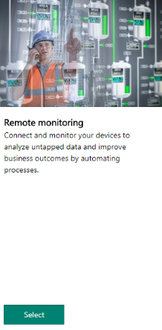
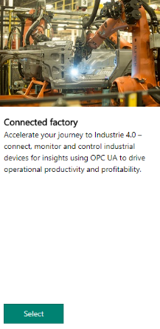
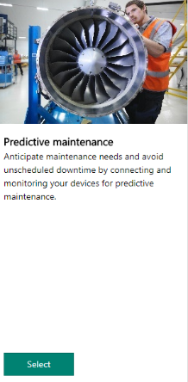
Microsoft Azure IoT Suite
Preconfigured Solutions
Deploy in minutes
End-to-end implementation
Completely customizable

Slide 12
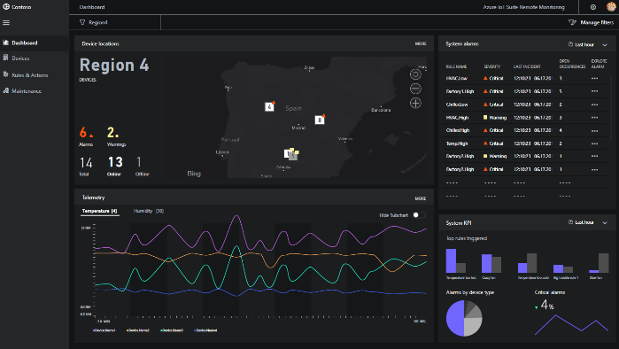
Announcing Remote Monitoring update
Open-sourced, microservices-based architecture
.NET & Java
Flexible UX framework (React)
Troubleshooting & Remediation Dashboard
Enhanced documentation
Image/chart/graph

Slide 13



Microsoft IoT Central
Builders
Administrators
Operators
Product Modeler
App Manager
Intuitive discoverability
Digital-twin Management
User Management
Asset Visualizations
Template Management
Identity Management
Time-series Insights
Rules & Workflows
Device Management

Slide 14
Build Things
Aircrafts
Cows
Street sweepers
Auto
Fryers
Electric charging stations
Oil equipment
Vending machines
Dogs
Buses
Power plant
Buildings
IoT
Factory floor
Racing
Trucks
Oil distribution
Elevators
Power tools
Vaccine dispensers
Mining equipment
Surveillance
Postboxes
Engines
Smart meters
Smart grids
Medical devices

Slide 15
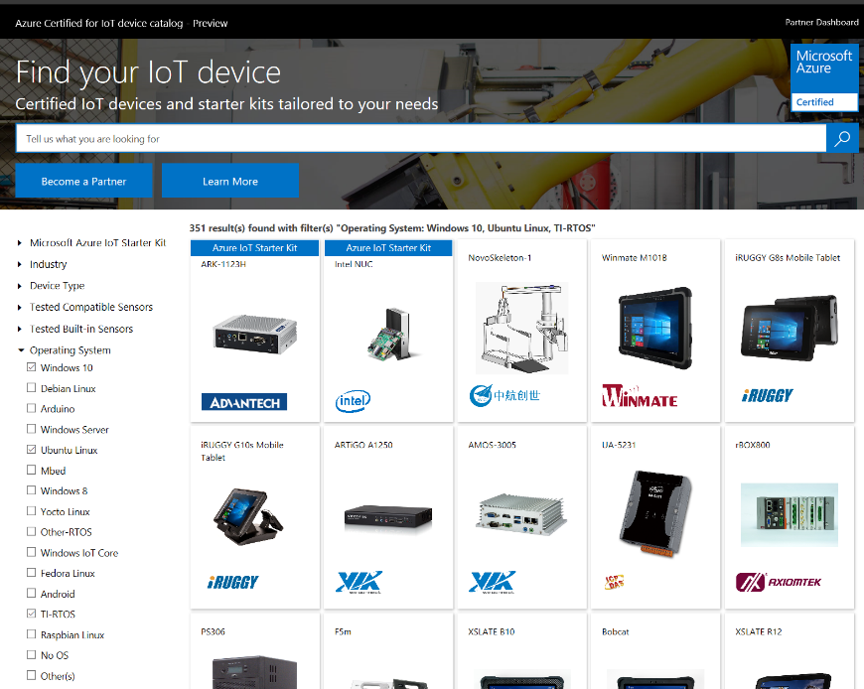
Microsoft Azure IoT Device Catalog
~580 certified devices
~200 partners
~250% growth YTD

Slide 16
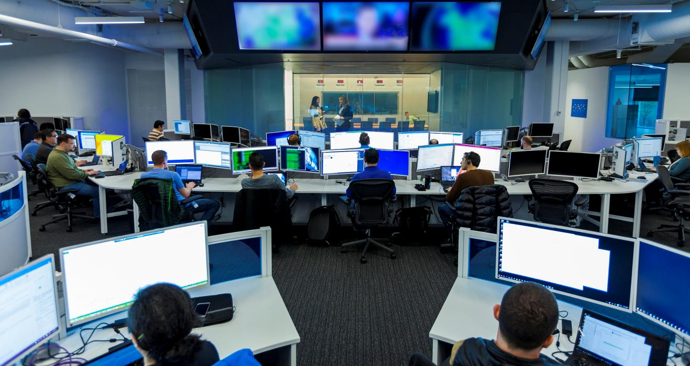
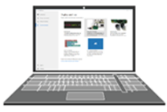

Windows 10 IoT
Option 2
Making it easy to build secure, intelligent and connected devices quickly and confidently
INTELLIGENT EDGE
INTELLIGENT SECURITY
FASTER TIME TO MARKET

Slide 17
Azure IoT Hub
Bi-directional communication
Enterprise scale & integration
End-to-End Security
Millions of Devices
Multi-language, open source SDKs
HTTPS/AMQPS/MQTTS
Send Telemetry
Receive Commands
Device Management
Device Twins
Queries & Jobs
Billions of messages
Scale up and down
Declarative Message Routes
File Upload
WebSockets & Multiplexing
Azure Monitor
Azure Resource Health
Configuration Management
Per Device Certificates
Per Device Enable/Disable
TLS Security
X.509 Support
IP Whitelisting/Blacklisting
Shared Access Polices
Firmware/Software Updates
Azure IoT Hub
Things
Insights
Actions

Slide 18
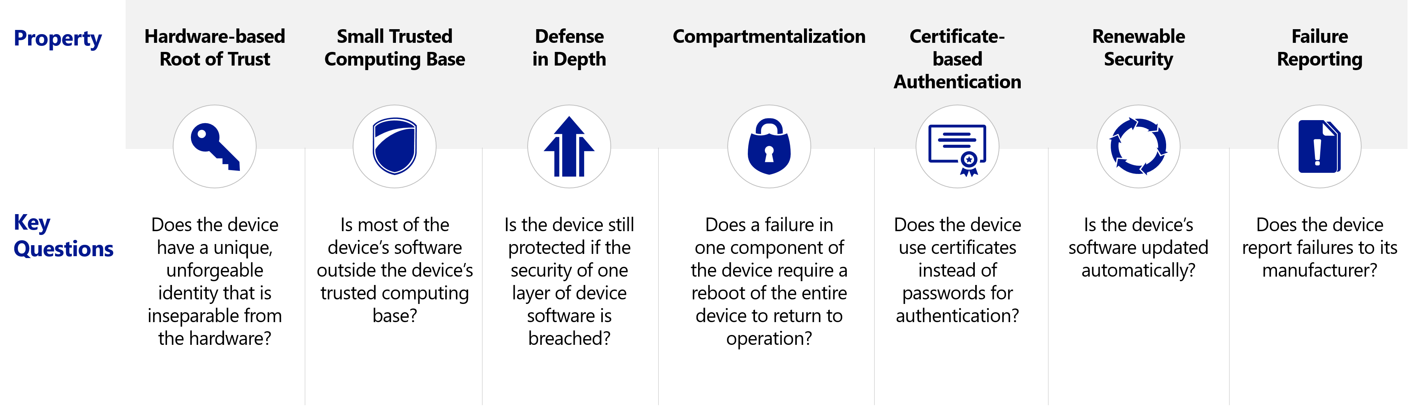
Driving Security Innovation: 7 Properties of Device Security
Well understood security principles and practices
Device security rooted in hardware, but guarded with secure, evolving software
aka.ms/7properties

Slide 19
Device to Cloud Security
For Sam: “remove Azure IoT”?
Security Program for Azure IoT
Device protection
Threat resistance
Data protection in-motion
Cloud security
Response
Trusted Platform Module (TPM)
Windows Device Health Attestation*
Secure Boot
BitLocker
DICE
Windows as a Service
Device Guard
Windows Firewall
Windows Defender*
X.509/TLS-Based Handshake and Encryption
Encryption at Rest
Azure Active Directory
Key Vault
Policy-Based Access Control
IP- based blocking
Secure Device Registration
Standards-based best practices
Device Management
Device Recovery
Device-specific repudiation
*Only available on Windows IoT Enterprise

Slide 20










Security Program for Azure IoT
SUSAN: nothing to change here for now.
For Sam: “remove Azure IoT”?
Microsoft’s Security Program
Trusted security auditors trained on Azure IoT
Discover issues, get recommended remediations
Keep your IoT Solution secure
10th Magnitude
AppSec Labs LTD
AUJAS Information Risk Services
Casaba Security LLC
Crowe Horwath LLP
CyberX
Microsoft Enterprise Services
OccamSec LLC
Praetorian
SecureGUARD GmbH
Tech Mahindra
Unisys Corporation
Not all partners may be listed; check internetofyourthings.com for latest status

Slide 21
Azure IoT Edge & Wave of Innovation
Cloud
Globally available, unlimited compute resources
IoT
Harnessing signals from sensors and devices, managed centrally by the cloud
Edge
Intelligence offloaded from the cloud to IoT devices
AI
Breakthrough intelligence capabilities, in the cloud and on the edge

Slide 22
IoT Pattern + Edge
Azure IoT Edge
Azure IoT Hub
Things
Cloud Gateway
Insights
Actions
Insights
Actions

Slide 23
IoT in the Cloud and on the Edge
How can we make these slides feel like they are from the same family?
IoT in the Cloud
Remote monitoring and management
Merging remote data from multiple IoT devices
Infinite compute and storage to train machine learning and other advanced AI tools
IoT on the Edge
Low latency tight control loops require near real-time response
Protocol translation & data normalization
Privacy of data and protection of IP
Symmetry

Slide 24

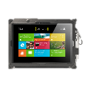







Today’s SCADA solution
Well site
SMS/email alert
$$$$$
Supervision site

Slide 25




IoT Edge and AzureML in action
Well site
Replaying pump readings
Azure IoT Edge

Slide 26
IoT Device Management Lifecycle
Check next slide for graphic – example of DM working via Firmware update operations
Replace or decommission devices after failure, upgrade cycle or service lifetime
Group devices and control access according to your organization's needs
Retire
Plan
Monitor
Provision
Monitor device inventory, health & security while providing proactive remediation of issues
Securely authenticate devices, on-board for management and provision for service
Configure
Provide updates, configuration & applications to assign the purpose of each device

Slide 27
Azure IoT Hub Device Management
Query
Software
Firmware
Configuration
Power plant
Device twin
Device twin
Elevators
Smart meters
IoT Hub
Medical devices
Buildings

Slide 28

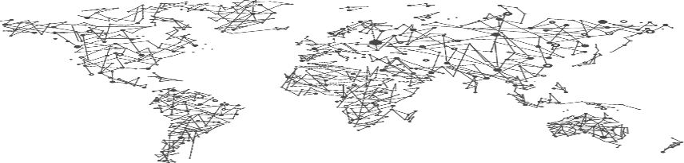
Available: Azure IoT Hub Device Provisioning Service
Azure IoT Hub
Device Provisioning Service
IoT Hub US
IoT Hub Germany
IoT Hub China

Slide 29
Microsoft IoT
SOLUTIONS
THINGS
INSIGHTS
Discover
Operationalize
Refine
ACTIONS

Slide 30
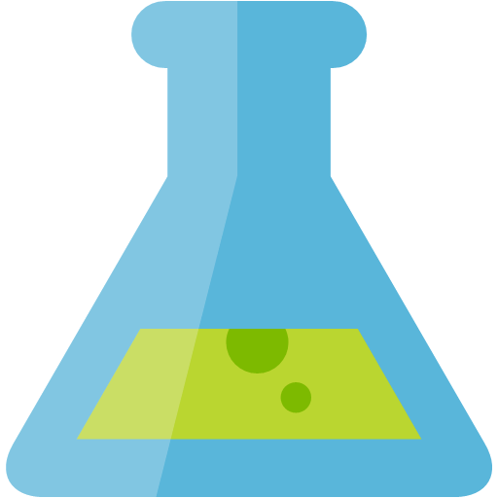

Discover
Mine historical data
Discover trends and patterns
Find key insights
MACHINE LEARNING
TIME SERIES INSIGHTS
HDINSIGHTS
R SERVER

Slide 31
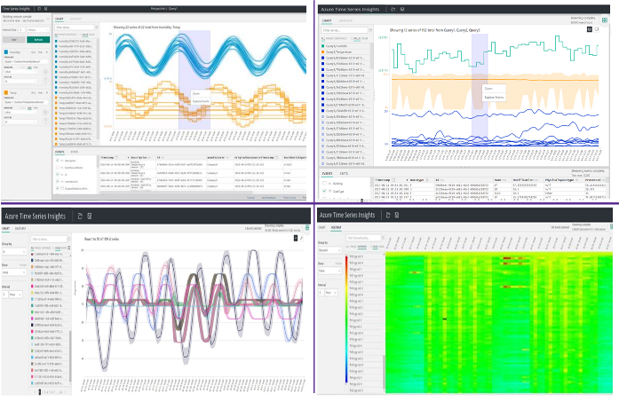
Azure Time Series Insights
IoT scale time-series data store
Schema-less store, just send data
Easy IoT Hub connection
Store, query and visualize billions of events
Simple and fast navigation

Slide 32
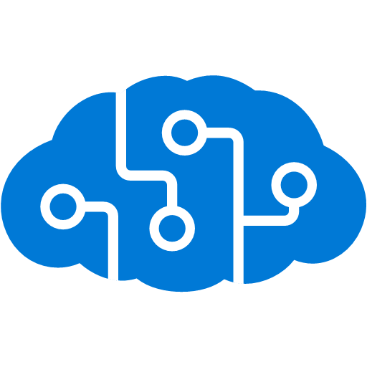




Operationalize
Implement rules/thresholds
Process real time data
Mission critical reporting
COGNITIVE SERVICES
MACHINE LEARNING
FUNCTIONS
STREAM ANALYTICS
HDINSIGHTS
R SERVER
STORM
SPARK

Slide 33
Azure Machine Learning
TRAIN & DEPLOY OPTIONS
Spark
SQL Server
Virtual machines
GPUs
Container services
AZURE MACHINE LEARNING SERVICES
AZURE
AI dev /
data scientist
workstation
CPU/GPU
ON-PREMISES
SQL Server
Machine Learning Server
Experimentation and Model Management
Notebooks
IDEs
Azure Machine Learning Workbench
EDGE COMPUTING
Azure IoT Edge

Slide 34
Microsoft IoT
SOLUTIONS
THINGS
INSIGHTS
ACTIONS
Respond
Integrate
Improve

Slide 35

Taking action, enabled digital transformation
Engage customers
Empower employees
Optimize operations
Transform products

Slide 36

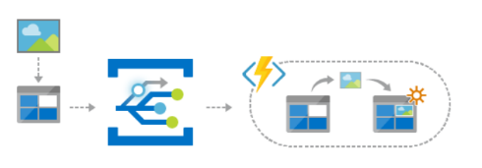
Respond
Manage devices
Send notifications and alerts
Execute workflows
IoT HUB
NOTIFICATION HUB
SERVICE BUS
EVENT GRID

Slide 37

Integrate
Update and order inventory
Schedule maintenance
Empower employees (AR/VR)
LOGIC APPS
MICROSOFT FLOW
Dynamics 365
HoloLens
DYNAMICS 365
HOLOLENS

Slide 38







Azure IoT Content Map
READINESS
IoT SCHOOL AND IoT SHOW
DATA INSIGHTS CAPABILITY GUIDES
SOLUTION ARCHITECTURE
This site will help you discover and navigate to all the great learning content that’s out there about Azure IoT. You can now easily access a wide range of content type to learn at your own pace, and end to end, all about Azure IoT services and technologies.
Capability guides are provided by the Business Architect team that is part of the Data Insights Global Practice. The purpose of these guides is to provide sellers with prescriptive guidance in how to position and sell solutions to a business audience.
The Book of Dreams is a set of scenarios for industry verticals for driving digital business transformation with business leaders.
Title & Link | Industry
Airlines Book of Dreams | Airlines
Automotive Book of Dreams | Automotive
CityNext Book of Dreams | Cities
Consumer Electronics Book of Dreams | Electronics
Healthcare Book of Dreams | Healthcare
Insurance Book of Dreams | Insurance
Manufacturing Book of Dreams | Manufacturing
Oil & Gas Book of Dreams | Oil & Gas
Retail Book of Dreams | Retail
Title & Link | Owner
Azure IoT School | Olivier Bloch
Channel 9 Internet of Things Show | Olivier Bloch
Title & Link | Owner
Fraud Detection Capability Guide | DISG
Predictive Maintenance Capability Guide | DISG
Remote Diagnostics Capability Guide | DISG
Sentiment Analytics Capability Guide | DISG
Smart Networks Capability Guide | DISG
Manufacturing Remote Monitoring IoT Design Strategies
IoT WEBCASTS
Title & Link | Date
Building an IoT SaaS Application with Azure IoT Central | 12/6/2017
Extending the Intelligent Cloud to Edge Devices | 11/28/2017
Building Reliable IoT Solutions in the Cloud, Fast | 11/6/2017
Complementing Azure IoT Platform Security at the Edge | 11/2/2017
Understanding the Azure IoT Platform | 10/12/2017
Azure IoT: Vision and Roadmap | 10/2/2017
Create Custom Solutions for Your IoT Scenarios | 1/25/2017
Integrate and Transform Business Processes with Azure IoT | 1/24/2017
Analyze, Monitor and Act on Data with Azure IoT | 1/18/2017
Connect, Manage and Scale Efficiently with Azure IoT | 1/17/2017
The IoT Competitive Landscape and How Microsoft Differentiates Itself from The Competition | 8/24/2016
Understanding Microsoft’s View on The Internet of Things (IoT) Market and Ecosystem | 7/26/2016
MANUFACTURING INDUSTRY CONTENT
SERVICES
Microsoft Services has an extensive set of Offers and Solutions related to IoT on Service Portfolio
Here is a link to the IoT Services BoM
Title & Link
Solution Pitch Deck – Remote Monitoring - Manufacturing
Remote Monitoring At-a-Glance
Predictive Maintenance At-a-Glance
Predictive Maintenance BDM deck
Connected Factory Manufacturing Solution Deck
Factory of the Future Infographic
CLOUD WORKSHOPS
Title & Link | Location
IoT for Business | Github
Intelligent Vending Machines | Github
TUTORIALS
Title & Link
BUILD 2018 IoT Sessions
Title & Link | Location
IoT Central Quickstart tutorial | Docs
Microsoft.com/internet-of-things
1

